Slide 1
Vanishing tilt-to-length coupling for a singular case in two-beam laser interferometers with Gaussian beams
Sönke Schuster, Gudrun Wanner, Michael Tröbs, and Gerhard Heinzel
Paul Edwards

Slide 2
Sections
Introduction
Geometrical Coupling
Plane Waves
Gaussian Beams
Discussion
Conclusions

Slide 3
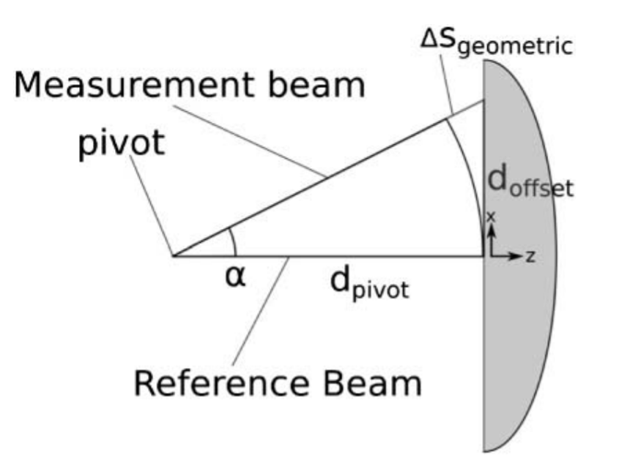
1. Introduction
Beam misalignments couple into interferometric length readouts (TTL coupling)
Described as geometrical pathlength changes of the measurement beam axis
TTL coupling is cancelled to first-order for the special case:
Identical Gaussian-Gaussian beam interference
Large detector (no clipping), directly on the beam axis

Slide 4
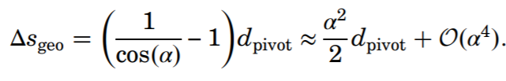
2. Geometrical Coupling
PD detects interference of measurement and reference beam
For a tilted measurement beam:
Phase difference → Longitudinal Pathlength Sensing signal (s_{LPS}), vanishes at 1st-order
Arises from geometrical pathlength difference Δs_{geo}
d_{pivot} = (d_{pivot}+ Δs_{geo})cos(α)…

Slide 5
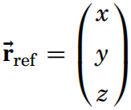
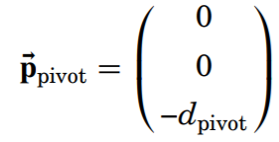
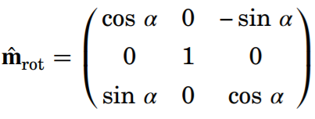
(2.) Tilted Gaussian-Gaussian Interference
Reference beam centered on PD:
Measurement beam tilted by α:

Slide 6
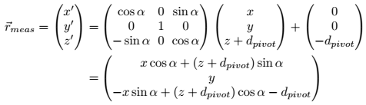
(2.) Measurement Beam Coordinate Transformation
Measurement beam tilted by α:
Let z_{COR} = -d_{pivot}:

Slide 7
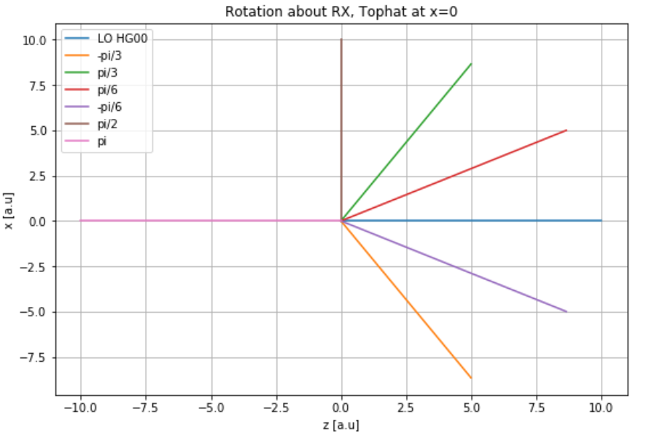
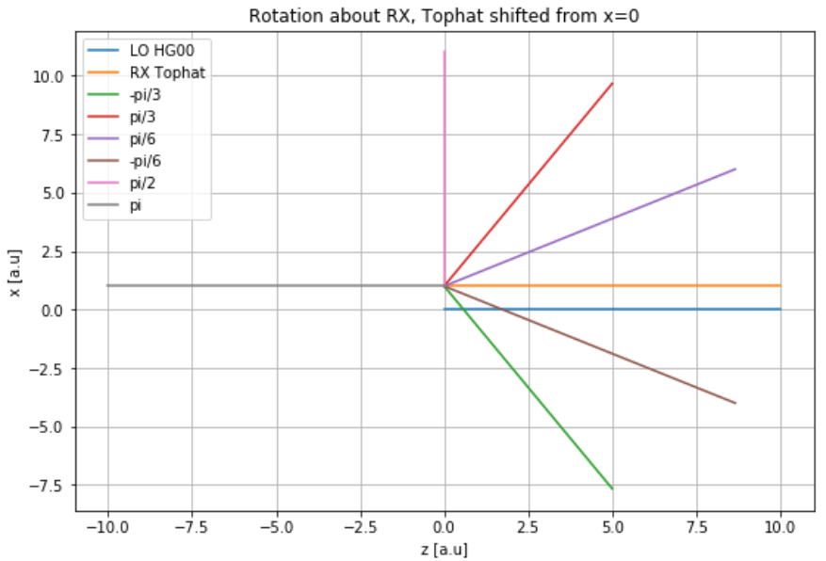
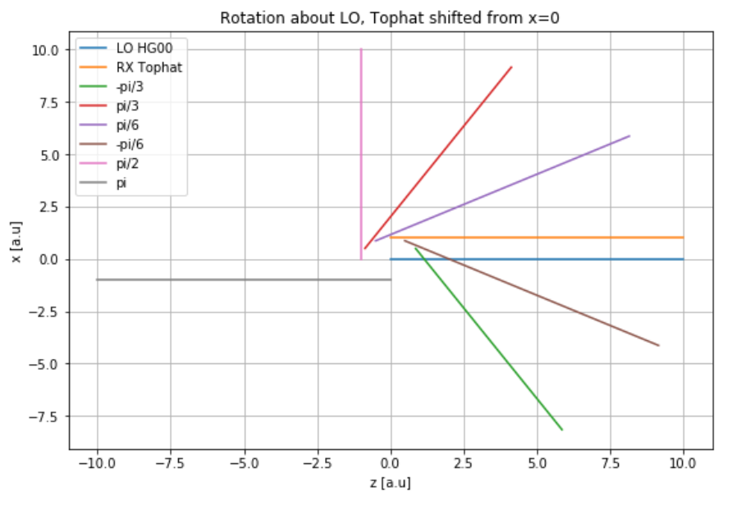
(2.) Measurement Beam Centers of Rotation (COR)
Introduce offset

Slide 8

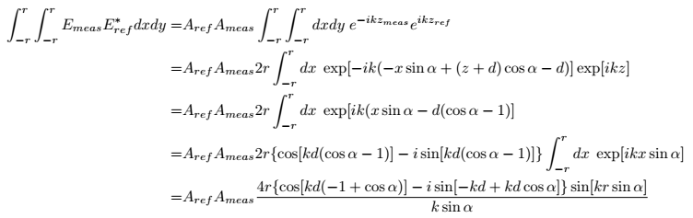
3. Plane Waves
Infinite plane wave:
For the tilted measurement beam:
Extract the path length difference from complex phase of the integral over the overlap term:
Integration of the overlap term (square detector, z = 0, side = 2r):

Slide 9
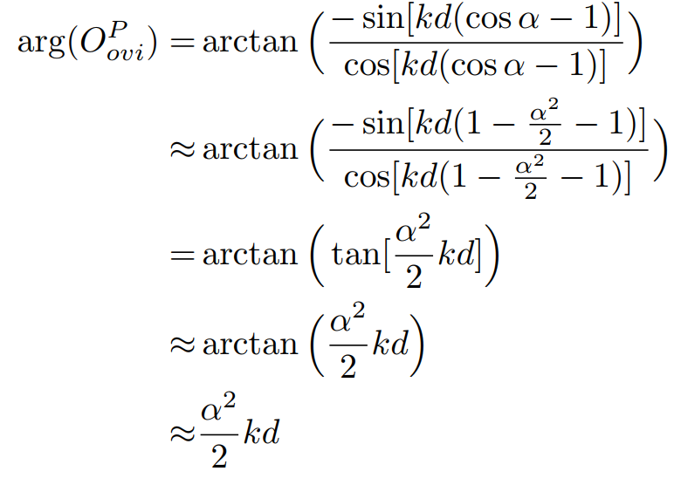

(3.) Path length difference
Expanding:
Translate to s_{lps}
The path length difference matches geometrical analysis (for plane waves).

Slide 10

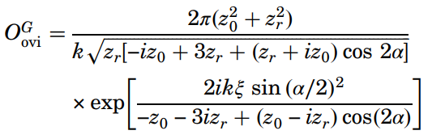


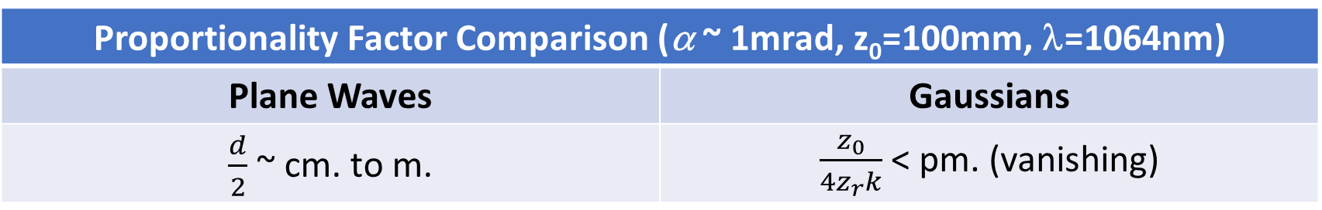
4. Gaussian Beams
Consider the special case of two identical Gaussians at infinite PD
Neglecting amplitude and Gouy phase:
Integral of the overlap term (infinite PD, z = 0):
The path length change:
Proportionality Factor Comparison (α ~ 1mrad, z₀=100mm, λ=1064nm)
Plane Waves | Gaussians
$\frac{d}{2}$ ~ cm. to m. | $\frac{z_{0}}{4z_{r}k}$ < pm. (vanishing)
1.43e-5 pm

Slide 11
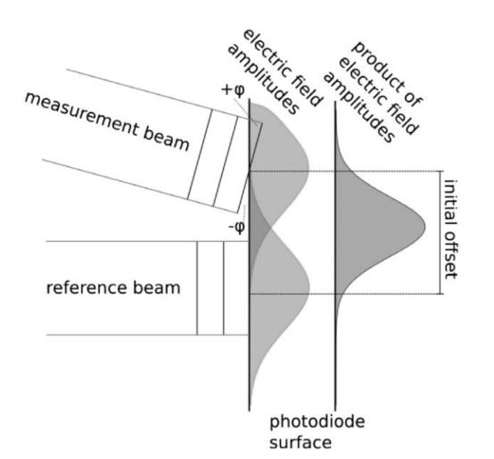

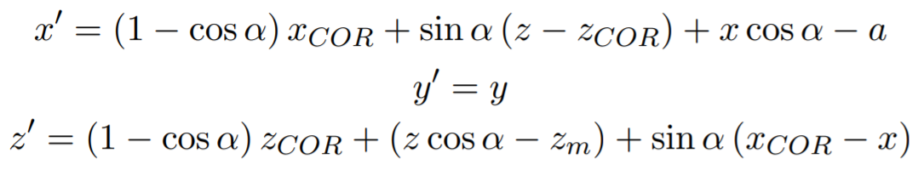
(4.) Additional Coupling Effects
Two reasons for vanishing coupling:
an angle-dependent pathlength change (Δs_{geo})
an angle-dependent offset (d_{offset})
A lateral offset is inconsequential for plane waves
Investigate effects of the offset for Gaussians
Introduce lateral offset, d_{offset}^{[2][3]}:
Tilt meas. beam about its center on SEPD (d_{pivot}=0)
Shift ref. beam:
General coordinate transformation for meas. beam would be:

Slide 12
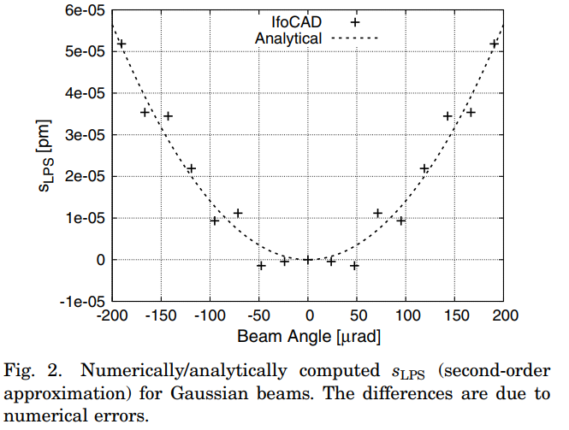
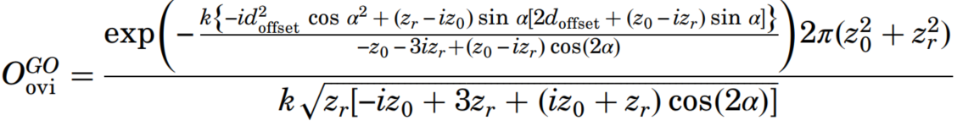



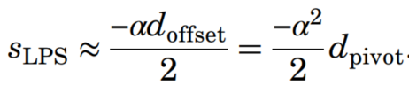
(4.) Additional Coupling Effects
For tilted, offset Gaussians:
Overlap integral
Path length change:
The offset as its geometric expression:
Combining the two above for path length change:
Compare to path length change from only tilting (equal,opposite):

Slide 13
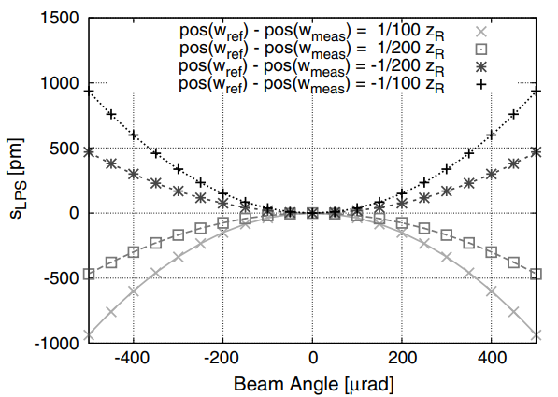

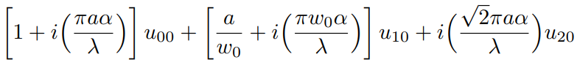
5. Discussion
Digression from the special case, Gaussians of different waist positions (numerical/analytical)
Tilted Gaussians can also be expressed as an excitation of the HG 01 mode (for small misalignments)

Slide 14
6. Conclusions
Shown that:
Computed coupling between two plane waves match expected path length change
Coupling “vanishes” in LPS for two identical gaussians on large SEPD

Slide 15
References
[1] Sönke Schuster, Gudrun Wanner, Michael Tröbs, and Gerhard Heinzel, "Vanishing tilt-to-length coupling for a singular case in two-beam laser interferometers with Gaussian beams," Appl. Opt. 54, 1010-1014 (2015).
[2] Gudrun Wanner and Gerhard Heinzel, "Analytical description of interference between two misaligned and mismatched complete Gaussian beams," Appl. Opt. 53, 3043-3048 (2014).
[3] D. Anderson, “Alignment of resonant optical cavities,” Appl. Opt. 23, 2944–2949 (1984).

